Slide 1
Concurrency –
Intro. & Basic Concepts
Dr. Dayang Norhayati Abang Jawawi
&
Assoc. Prof. Dr. Rosbi bin Mamat

Slide 2
1. Intro to Concurrency
What is Concurrency ?
Concurrency is when two or more programs execute ‘at the same time’ (concurrent programs)
Concurrent programs (CP) can be executed by sharing a processor, or on different processors.
Processor = HW on which the program execute
CP running on a processor is just an illusion provided by the operating system (OS) ! by techniques of multi-tasking or multi-threading. In reality, OS coordinates/schedules the CP to the same processor.

Slide 3
1. Intro to Concurrency
What is Concurrency ?
CP running on different processors (parallel processing) may be running:
  in the same machine (multi-processor architecture, multi-core processor), or
  in different machines (distributed computation).
Machine = processors + memories + I/O

Slide 4
1. Intro to Concurrency
Why Concurrency ?
To perform a computation more quickly to some specific problem by splitting it to many concurrently executable parts in order to exploit parallel processing, like in weather forecasting, scientific computing etc.

Slide 5
1. Intro to Concurrency
Why Concurrency ?
Increase the utilization of a traditional computer HW by multiplexing its components (CPU, disk, network interf.) between independent tasks like a PC with a multitasking OS. e.g: allow more than one client to access a server at a time, allow users to interact with a GUI while some computation proceeds etc.

Slide 6
1. Intro to Concurrency
Why Concurrency ?
Enable timely reaction & increased application responsiveness to asynchronous inputs, like in embedded systems in cars, planes, robots etc. For example: during autonomous movement of a robot, a sensor detect an obstacle & the robot readjust its route to avoid the obstacle.
non-responsive

Slide 7
1. Intro to Concurrency
Why Concurrency ?
Example of responsiveness
void main()
{
do {
check_keypad();
measure_temperature();
control_oven();
decrement_timer();
update_display();
wait_for_tick();
    } while (FOREVER)
}

Slide 8
1. Intro to Concurrency
Why Concurrency ?
Example of responsiveness
void main()
{
do {
check_keypad();
measure_temperature();
check_keypad();
control_oven();
check_keypad();
:
    } while (FOREVER)
}

Slide 9
1. Intro to Concurrency
Why Concurrency ?
Provide a modeling tool to build large scale systems with many asynchronous concurrent activities.
Enhance system fault-tolerance by replicating and executing the same component concurrently in independent machines.
A inherent paradigm to model and construct any distributed system.

Slide 10
1. Intro to Concurrency
Why Concurrency ?
Real world is parallel and asynchronous
  We need to extend our programming model from sequential to concurrent and asynchronous activities.
  The amount of parallelism in our programs should not be dictated by the number processor available, but by the problem we want to solve.

Slide 11
1. Intro to Concurrency
The Cost of Concurrency
Programmers trained on sequential program face difficulty & unfamiliar problems in CP: synchronization, race conditions, deadlocks, etc.
  CP errors contributed to accidents causing death and serious injury e.g. Therac-25.
  Problems with interaction between concurrent tasks caused periodic software resets reducing availability for exploration of Mars Rover robot

Slide 12
1. Intro to Concurrency
The Cost of Concurrency
To share one processor among many programs, one program has to be chosen to run; when its time is up, it has to be stopped, its current state stored, another program chosen to run, and its previous state restored — all of which takes time & require scheduler/OS supports.

Slide 13
1. Intro to Concurrency
The Cost of Concurrency
Communication between different processors takes time & the more processors, the more time it takes. When communications becomes dominance than the processing – communication bound. Is the concurrency worth it ?

Slide 14
2. Types of Concurrency
Semi-concurrency
  two or more processes will run on the same processor, one at a time, using and releasing the processor, managed by the OS.
True-concurrency
  many processes run on several processors at the same time (transputer environment)

Slide 15
2. Process vs. Thread
process provided by operating system (OS):
  has its own address space protected by OS + memory management unit (MMU)
  interacts with OS-system calls and shared state with other processes in the same host or via network interfaces (e.g. sockets) to processes in potentially different hosts.
  binding to other processes done dynamically at run time
  can be OS-dependent, context switch is heavy
thread provided by a threading library and OS:
  a light weight process as part of a concurrent program
  shares the program address space with its other threads
  interacts with other threads of the program using primitives of threading library and a possible programming language
  binding to other threads at compile time => more safe and portable
  context switches between threads in the same process are light

Slide 16
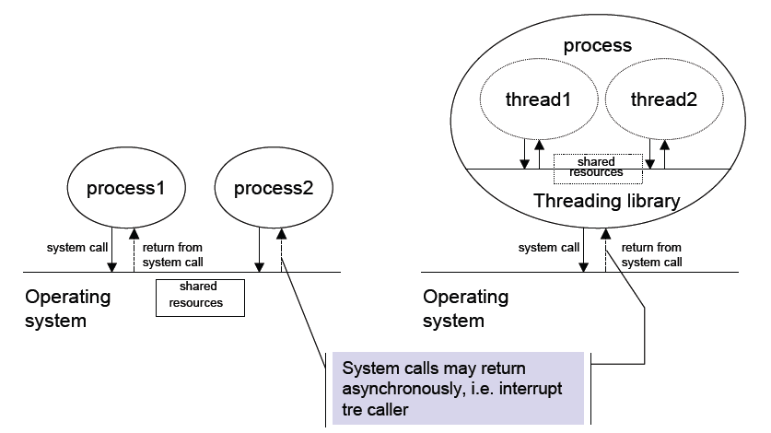
2. Process vs. Thread
H E L S I N K I U N I V E R S I T Y O F T E C H N O L O G Y

Slide 17
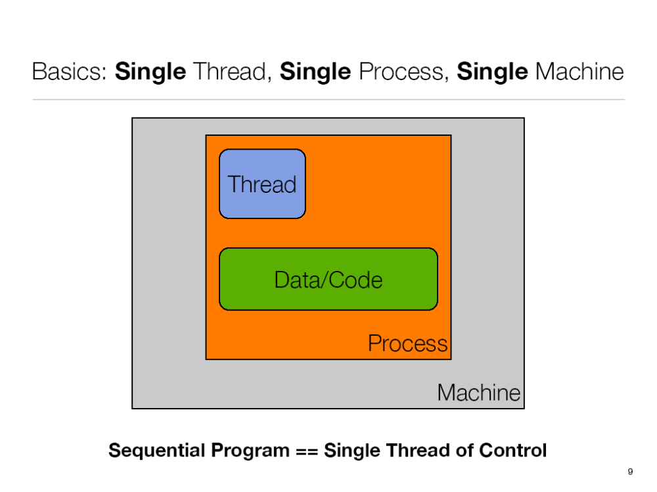
Anderson, University of Colorado

Slide 18
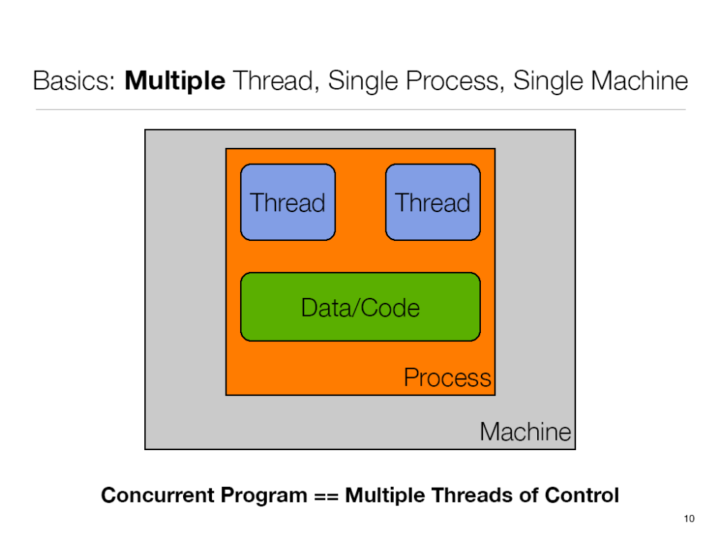
Anderson, University of Colorado

Slide 19
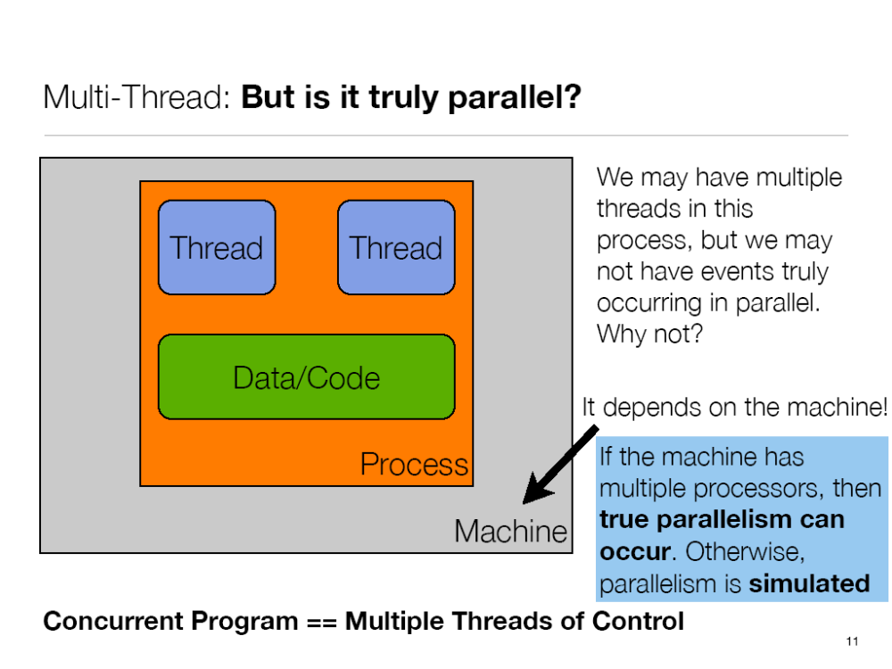
Anderson, University of Colorado

Slide 20
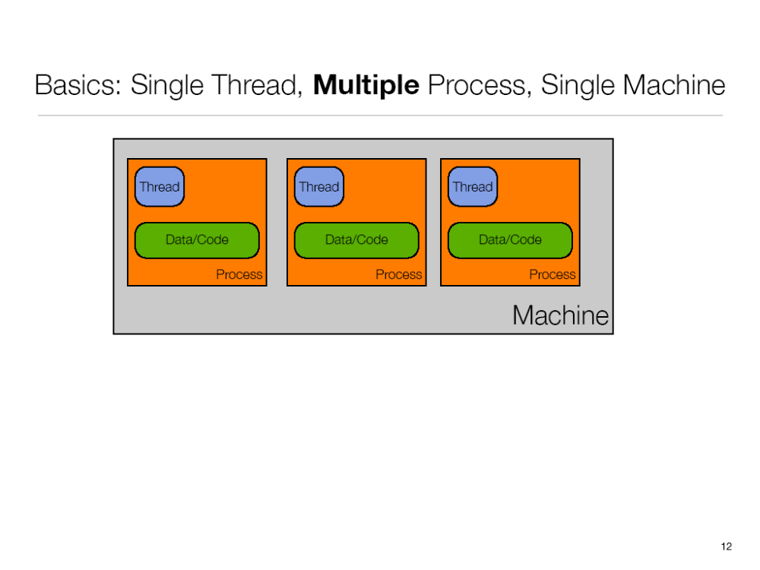
Anderson, University of Colorado

Slide 21
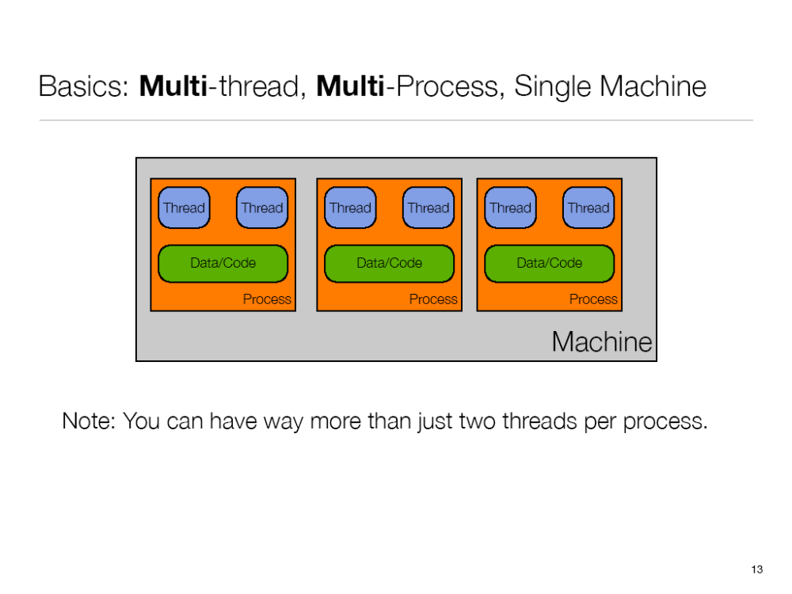
Anderson, University of Colorado

Slide 22
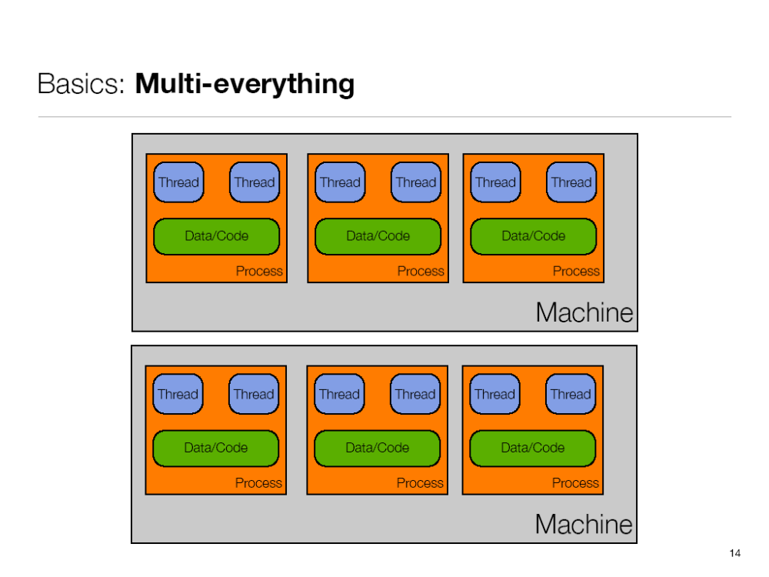
Anderson, University of Colorado

Slide 23
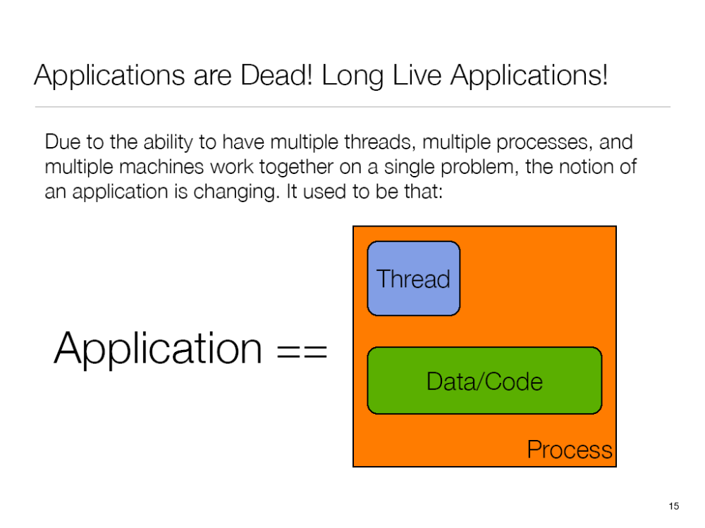
Anderson, University of Colorado

Slide 24
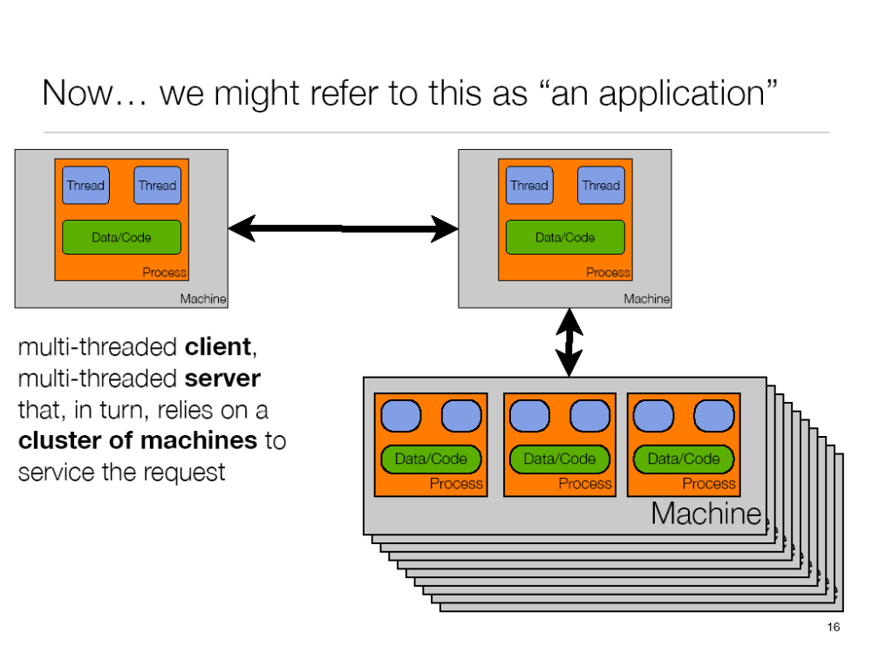
Anderson, University of Colorado

Slide 25

3. Sequential vs. Concurrent
A sequential program (SP) has a single thread of control.
A concurrent program (CP) has multiple threads of control allowing it perform multiple computations in parallel and to control multiple external activities which occur at the same time.

Slide 26
3. Sequential programming(SP)
In SP, processes are executed in order, one followed by another
Analogy : shopping in a supermarket
    buy meat, then buy vegetables, then buy drinks, then pay at the counter
For a given input, the computer always executes the same sequence of instructions.
Program is easier to write (logical)
Most probably not appropriate to solve real-time problems

Slide 27
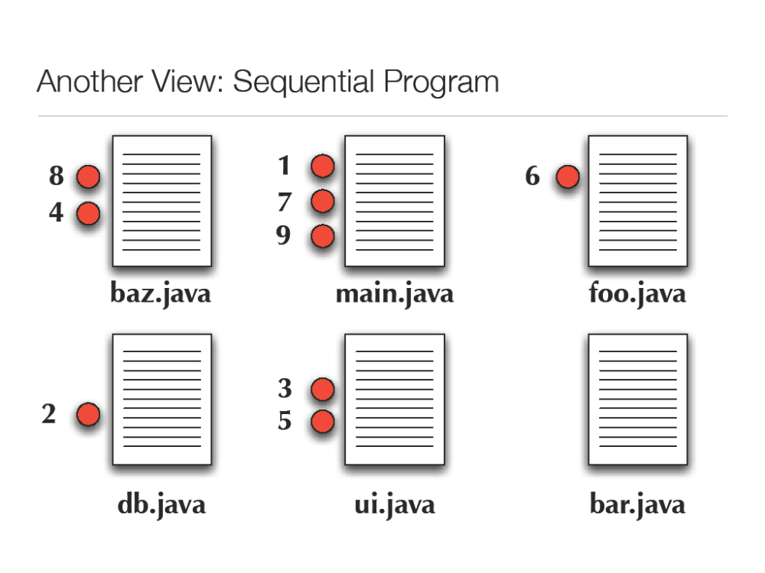
Anderson, University of Colorado

Slide 28
3. Concurrent programming(CP)
In CP, processes are executed in parallel
Analogy : shopping in a supermarket
    mother buys meat, father buys vegetables, son buys drinks (at once), then all meet before the pay counter
Harder to model and to program
Each time the sequence of execution of instructions is non-deterministic
Appropriate for time critical/ real-time problems

Slide 29
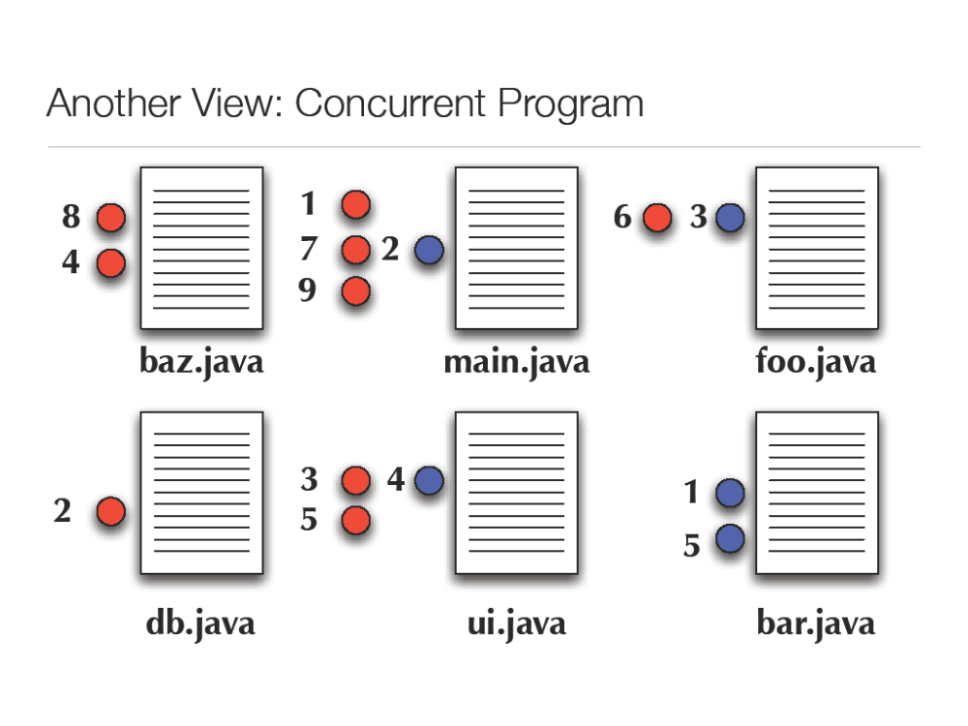
Anderson, University of Colorado

Slide 30
Activity 1 : Analogies
My sister is cooking
  1 menus
  Sequential : Single Thread, Single Process, Single Machine
My mom is cooking
  4 menus
  Concurrency : ??
My mom & sister are cooking
  2 menus each
  Concurrency : ??

Slide 31
4. Example of Concurrency
  solving a problem by decomposing it into several sub-tasks. Examples:
    Sort algorithms
    Summation of huge set of numbers
    Computing binomial coefficient

Slide 32
4. Mergesort
    procedure merge_sort is
    A : array(1..N) of Integer;
    procedure sort (Low, High : Integer);
    procedure merge;
    begin
    sort(1, N/2);
    sort(N/2+1, N);
    merge;
    end;

Slide 33
4. Mergesort
In SP, we sort each half of the array and then merge it. Eg. Input : 4, 2, 7, 6, 1, 8, 5, 0, 3, 9
4, 2, 7, 6, 1 1, 2, 4, 6, 7
8, 5, 0, 3, 9 0, 3, 5, 8, 9
((1, 2, 4, 6, 7 ), (0, 3, 5, 8, 9))
0, 1, 2, 3, 4, 5, 6, 7, 8, 9
sort
sort
merge

Slide 34
4. Mergesort
In CP, we assume there exist a few processors. Hence the two sorts can be done in parallel.
4, 2, 7, 6, 1 8, 5, 0, 3, 9
1, 2, 4, 6, 7 0, 3, 5, 8, 9
0, 1, 2, 3, 4, 5, 6, 7, 8, 9
sort
sort
merge

Slide 35
4. Mergesort
But there is more potential for parallelism, i.e all processes (sort1, sort2, merge) can be done concurrently.
(1, 2) ,... (0, 3),...
(0, 1, 2)
To do this, the merge process must be signalled to inform it that the partial sort results are available, while the data elements must be communicated.
merge
sort
sort

Slide 36
4. Summation of N numbers
X₁, X₂, X₃,… X_{n}
Process-1
Process-2
X₁ + X₂ + X₃,… +X_{n/2}
X_{n/2+1} + X_{n/2+2}, … +X_{n}
ADD
Process-3

Slide 37
Activity 2 : Grade 1 Math
Sum the following 16 numbers
23 45 67 356 78 -34 666 77 24 67 55 43 -90 456 -84 62
Time!

Slide 38
Activity 2
a friend to help you, to sum the following 16 numbers
84 38 555 -94 74 99 -201 9 46 301 62 -56 32 72 -111 49
Time!

Slide 39
4. Summation of N numbers
X₁, X₂, X₃,… X_{n}
+
Depth = 1
+
+
Depth = 2
+
+
+
Depth = 3
X₁ X₂ X₃ X₄ X₅ X₆ X_{n-1} X_{n}
+

Slide 40
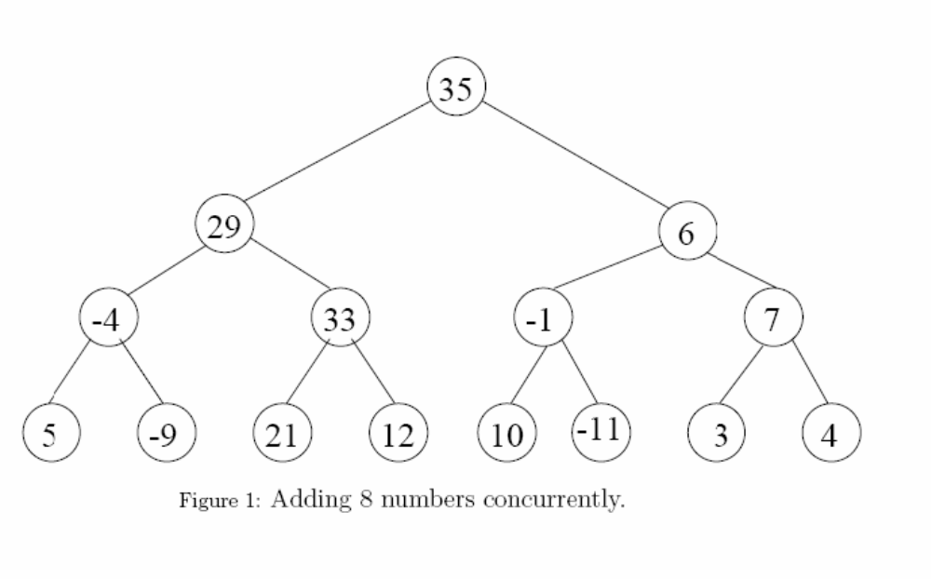
4. Summation of N numbers
Example sum of 8 numbers

Slide 41
4. Computing ^{n}C_{k}
^{n}C_{k} =n*(n-1)*…(n-k+1)
1*2*3……..*k
Process-1
numerator
=
Process-3
denominator
Process-2

Slide 42
5. Program vs. System
Discuss “Distinguish concurrent programs and concurrent systems”
5 minutes

Slide 43
5. Program vs. System
concurrent system:
  design based open interfaces (protocols) between processes to get loose coupling e.g. to extend the system dynamically at run time
  implementation: processes provided directly by the OS-kernel
  example in one host: processes in Unix connected with pipes instantiated from command shell.
  example on independent hosts: processes use TCP/IP trough sockets
  portability between hosts depends on the library and OS-primitives
concurrent program:
  based on concurrent programming language or threading library
  a subsystem or system component designed for a specific task
  composed at compile (linking) time
  e.g. a Java program using language concurrency features.
  portability comes with the language and it’s s.c. runtime system

Slide 44
6. The Nature of Concurrent Systems
Example – Temperature Control System
The primary function is to control the temperature in an engine jet pipe. This temperature is measured using the sensor, the resulting analogue signal is digitized, an error signal is calculated internally in the computer, and a correcting signal is output to the fuel valves via the DAC. The unit, however, is also required to perform several secondary tasks.
The pilot need to have access to all system information via the keypad/display unit.
The flight recorder must be able to acquire the same information using a serial data link.
Keypad
Display
DAC
Sensor
ADC
CPU
Serial I/O

Slide 45
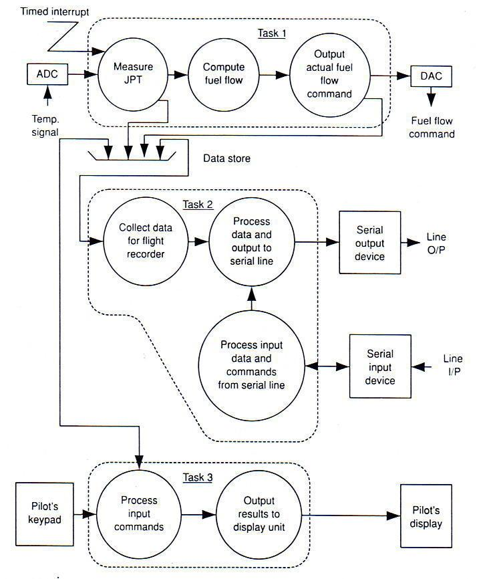
6. The Nature of Concurrent Systems
How?
Non-determinism
Process interaction
  Resource management
  Communication

Slide 46
6. The Nature of Concurrent Systems
Non-determinism
  there is uncertainty over the precise order of occurrence of some events
  may take different execution paths even when operating on the same input data
Process interaction: Resource management
  A process wishing to use a shared resource (e.g. a printer) must first acquire the resource, that is, obtain permission to access it.
Process interaction: Communication
  Synchronous
  Asynchronous

Slide 47
6. The Nature of Concurrent Systems
This raises a number of interesting problems:
task scheduling - we have to decide when and why tasks should run
mutual exclusion - we have to police the use of resources shared between tasks, to prevent damage or corruption to such resources
synchronization and data transfer- tasks must be able to 'speak' to each other, communication facilities are needed.

Slide 48
7. Problems in Concurrent Programming
Violating mutual exclusion
Deadlock
Indefinite postponement
Unfairness
Busy waiting
Transient errors

Slide 49
Group Quiz
Identify the concurrency problem in the following cases. Give reason for your answer.
Task A is waiting for Task B to release resources but Task B is holding the resource forever.
A concurrent program to add two numbers (2 and 2), 1st run will give answer 2 & second run give number 4.
An execution of a task is checking for availability of a resources, every time the task check on the resource, it not available, so the task cannot be executed.
2 task running on 2 machines. Task A running on a faster machine and Task B running on slower machine. Both tasks share Resources Z, due to the speed only Task A manages to use the resource.

Slide 50
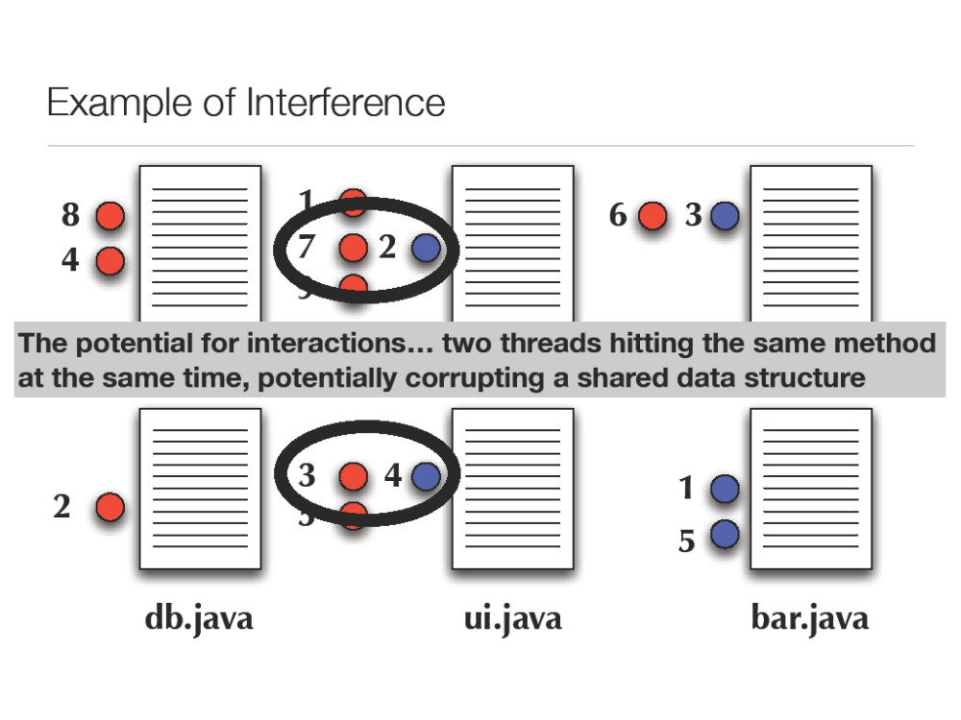
Activity 3
Given the following concurrency problem. Map it with the CP problems.

